Slide 1
Week 10 Exercises: EXIOBASE intro
Glenn A. Aguilar-Hernandez
March 08, 2o22

Slide 2
Today’s agenda
Time | Activity
15.20 – 15.25 | Part 1: Introduction
15.25 – 15.40 | Question 1, 2 & 3
15.40 – 15.50 | Review Question 1, 2 & 3
15.50 – 16.00 | Download EXIOBASE
16.00 – 16.05 | Review EXIOBASE
16.05 – 16.20 | Break
16.20 – 16.25 | Part 2: Introduction
16.25 – 16.45 | Develop code
16.45 – 17.00 | Review code

Slide 3
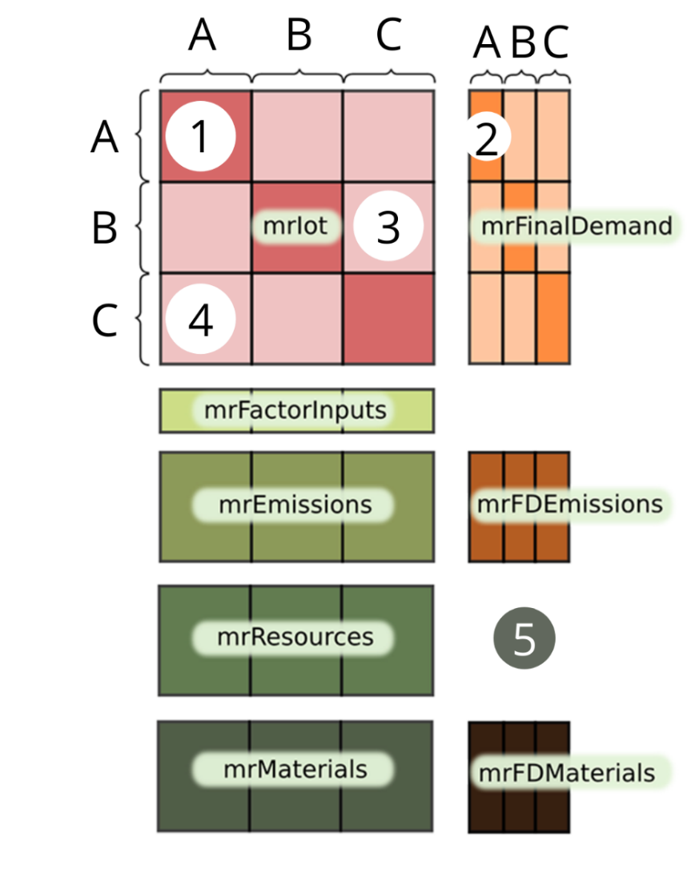
Part 1: Introduction
Figure 1. EXIOBASE structure

Slide 4

Review Question 1, 2 & 3

Slide 5
Download EXIOBASE
Let’s go to https://www.exiobase.eu/

Slide 6


Part 2: Introduction
using

Slide 7
Review code
Let’s go to Python!

